Slide 1
Spring Boot Series – Day 11
Topic: Customizing Spring Security – JWT Filters, Authentication Providers & Entry Points
@CodeByHaindavi | #SpringWithMe

Slide 2
Why Customize Spring Security?
✔️ Spring Security gives you a solid foundation — but real-world projects demand more than just out-of-the-box behavior.
✔️ You need control over how authentication works — from extracting JWT tokens to verifying users from your own database, not someone else's default.
✔️ That's where custom components come in — filters to intercept tokens, providers to validate credentials your way, and entry points to return clean JSON errors instead of HTML junk.
✔️ And the best part? These aren’t hacks — they’re first-class hooks built into the Spring Security chain, designed for you to take control without breaking the system.
@CodeByHaindavi | #SpringWithMe

Slide 3
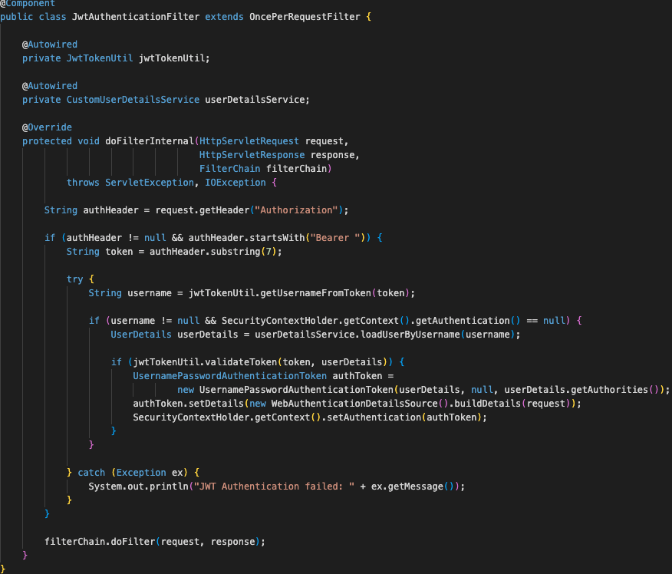
JWT Filter – What & Why?
✔️ Before Spring Security even begins its checks, your custom JWT filter steps in — giving you the first chance to inspect the incoming request.
✔️ It grabs the JWT token from the Authorization header and validates it using your own rules — checking integrity, expiry, and signature.
✔️ If everything looks good, it creates an Authentication object based on the token’s data — like username and roles — and injects it directly into the Spring Security context.
✔️ This way, every secured request now carries a verified identity — and if the token’s missing or invalid, it stops right there. No identity, no access.
@CodeByHaindavi | #SpringWithMe

Slide 4
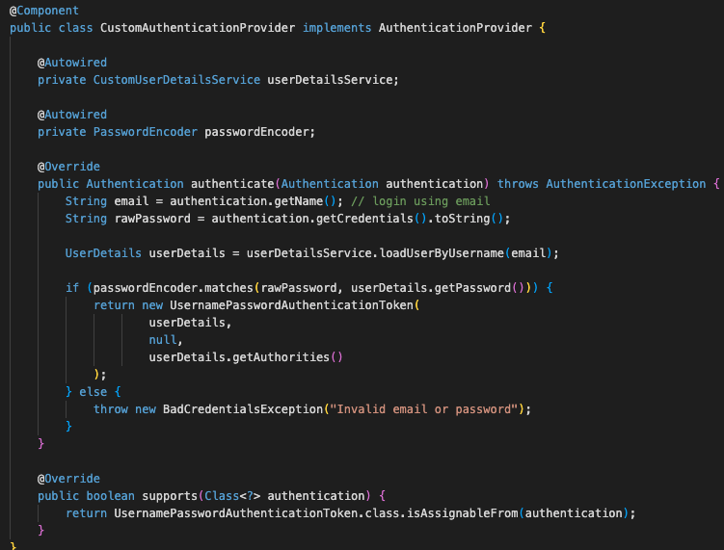
Custom AuthenticationProvider – What & Why?
✔️ The default UsernamePasswordAuthenticationProvider works — until your project needs something more than basic username-password checks.
✔️ That’s when you bring in a custom AuthenticationProvider — so you can write your own login logic, fetch users your way, and apply custom credential rules.
✔️ Whether it’s validating OTPs, handling multi-factor authentication, or connecting to external identity systems — this is where full control starts.
✔️ It doesn’t just authenticate — it lets you define what “authentication” even means for your application.
@CodeByHaindavi | #SpringWithMe

Slide 5
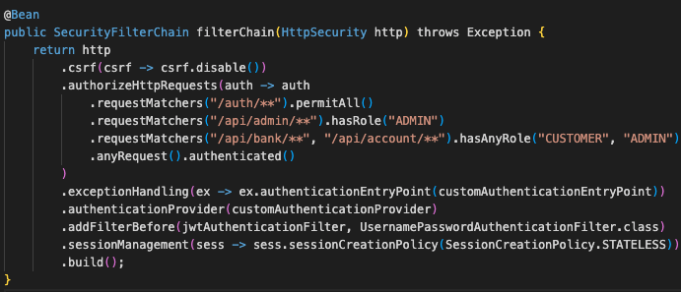
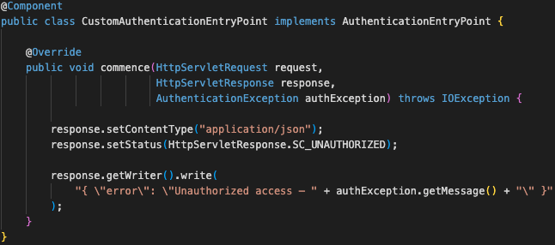
AuthenticationEntryPoint – What & Why?
✔️ When an unauthenticated user hits a protected endpoint, Spring by default responds with an HTML error page — which makes zero sense for REST APIs.
✔️ A custom AuthenticationEntryPoint takes over that response — and instead of HTML, returns a clean, structured JSON with a proper 401 status.
✔️ This keeps the API response format consistent, avoids confusion on the client side, and makes debugging much easier during integration.
✔️ It’s not just about pretty errors — it’s about telling the frontend exactly why access failed, without leaking stack traces or internal messages.
@CodeByHaindavi | #SpringWithMe

Slide 6
📌 Hands-On Tip
✔️ Always register your custom filter before UsernamePasswordAuthenticationFilter using .addFilterBefore() — this ensures JWT is validated before Spring checks session or form login.
✔️ Log the token, username, and SecurityContext during development — this helps you debug “token valid but user still unauthorized” issues without guessing.
✔️ Use UserDetailsService even in JWT filter to ensure role-based access (e.g., hasRole("ADMIN")) still works — Spring Security loads roles from the authenticated user.
✔️ Centralize your role names as constants (ROLE_ADMIN, ROLE_CUSTOMER) — it avoids typos and keeps your access rules consistent across annotations and filters.
✔️ Return structured error messages from your AuthenticationEntryPoint — avoid exposing stack traces or internal exception names. Use generic errors like "Unauthorized access" or "Invalid credentials" for clarity and security.
@CodeByHaindavi | #SpringWithMe

Slide 7
💼 Interview Insight
How do you validate a JWT token and inject the user identity into Spring Security context?
• We use a custom filter that extends OncePerRequestFilter. • It extracts the token from the Authorization header, validates it using a utility class, and then loads user details via UserDetailsService. • If valid, we manually create an Authentication object and set it in SecurityContextHolder, so that downstream access rules (like hasRole) work as expected.
How do you handle unauthorized access for REST APIs without exposing default HTML error pages?
• We create a custom AuthenticationEntryPoint and register it in the SecurityFilterChain. • It overrides Spring's default behavior and sends back structured JSON (e.g., { "error": "Unauthorized" }) with status 401. • This keeps the response consistent with the API's format and avoids leaking internal details.
@CodeByHaindavi | #SpringWithMe

Slide 8
📌 Recap – Day 11
🔐 Custom JWT Filter – Auth starts here. It extracts the token, validates it, and sets the user identity before Spring takes over.
🧠 AuthenticationProvider – You write the rules. Full control over how credentials are verified — whether it’s password, OTP, or custom logic.
📦 AuthenticationEntryPoint – Clean API errors. Sends structured 401 responses instead of Spring’s default HTML pages.
⚙️ Together, they form a complete, flexible, production-grade security flow — not just blocking users, but defining how authentication and access are handled.
👉 Coming up next: Spring Security — Custom AccessDeniedHandler & Error Response Design
@CodeByHaindavi | #SpringWithMe

